Slide 1

FlyOuT

Slide 2
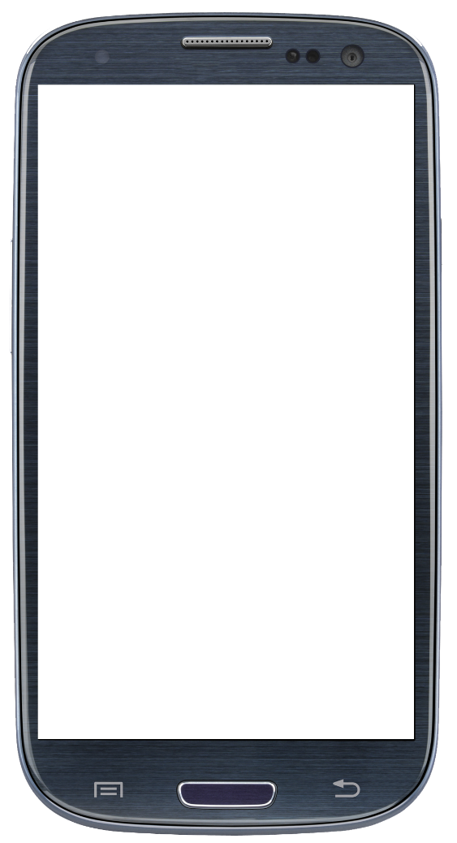
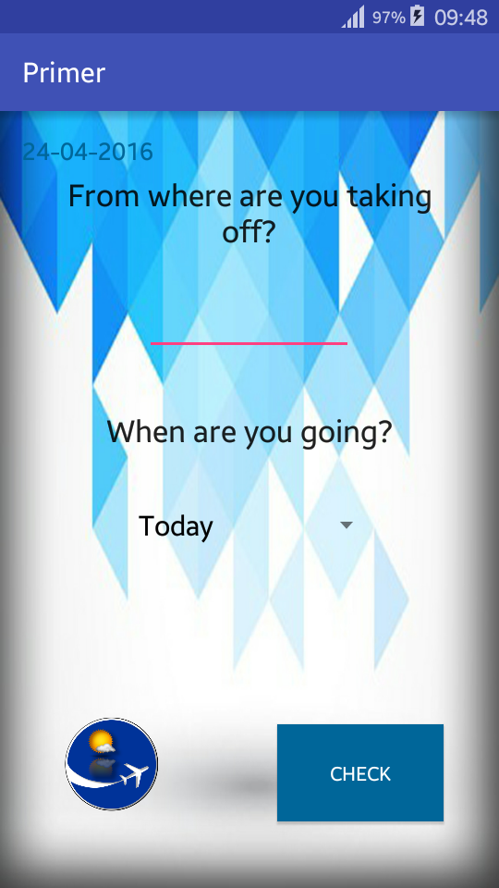
<string name=“hello_world”> HELLO WORLD! </string>
What is actually FlyOuT
Why we have the need for such application

Slide 3
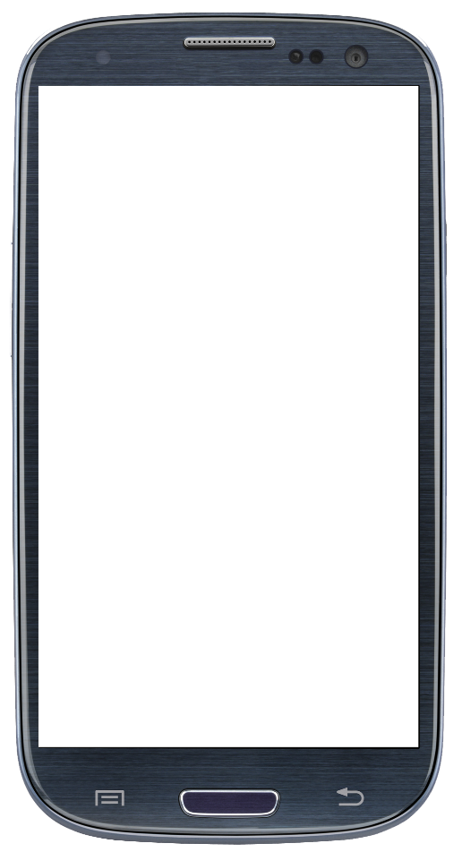
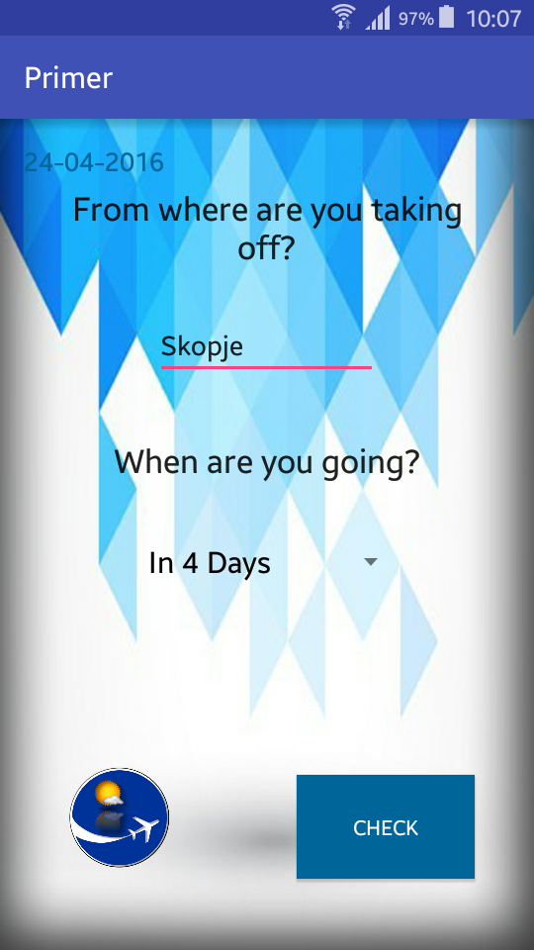
How do we use FlyOuT
Start with choosing a location from where you take off
Right after that choose the date when will you take off

Slide 4
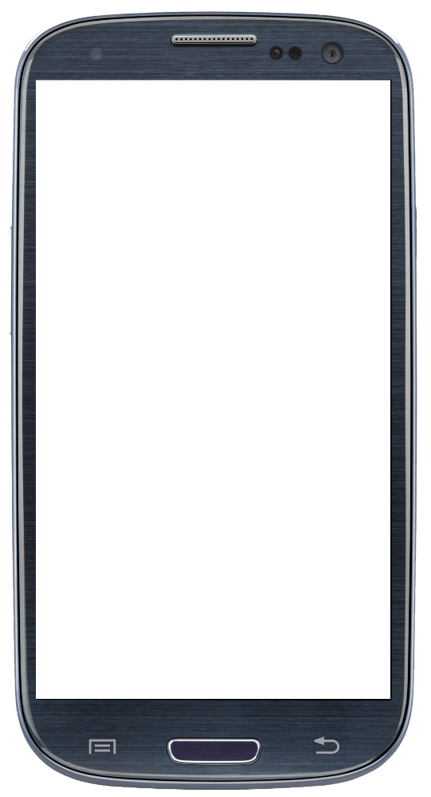
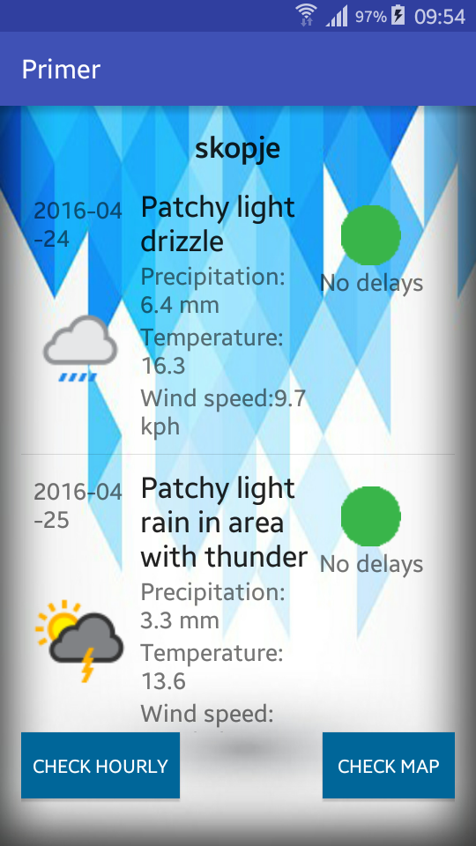
Right after choosing CHECK
List of the weather results for your chosen location

Slide 5
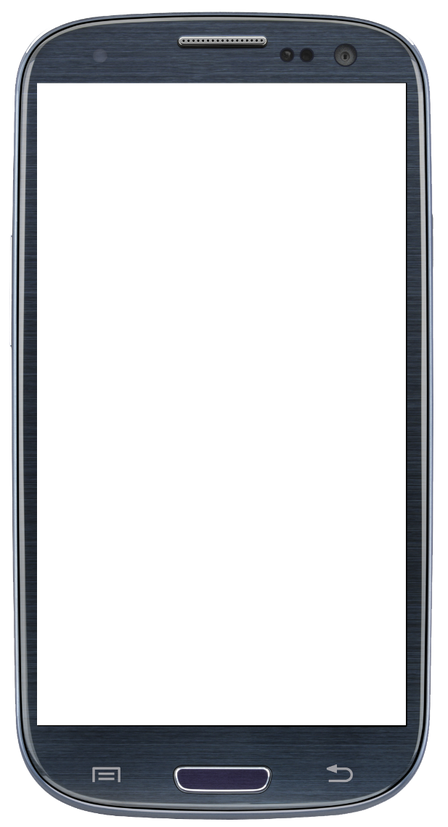
More options
Two buttons
CHECK HOURLY gives weather info for every hour
CHECK MAP gives you the map location from your take
off

Slide 6
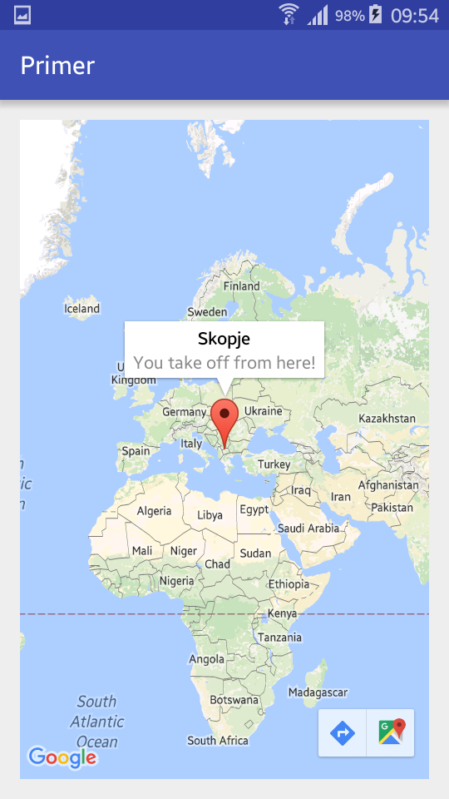
The map
The final view
Marker from your location

Slide 7
